Slide 1
Privacy Resilience in Genomic Data:
Analysis & Cybersecurity Defense
Presented by:
Lulu Allen
https://pubmed.ncbi.nlm.nih.gov/40534991/
https://pubmed.ncbi.nlm.nih.gov/34022422/
https://www.linkedin.com/in/lulu-allen/
CS 800 - Research Methods
Assignment 5
March 31, 2026

Slide 2
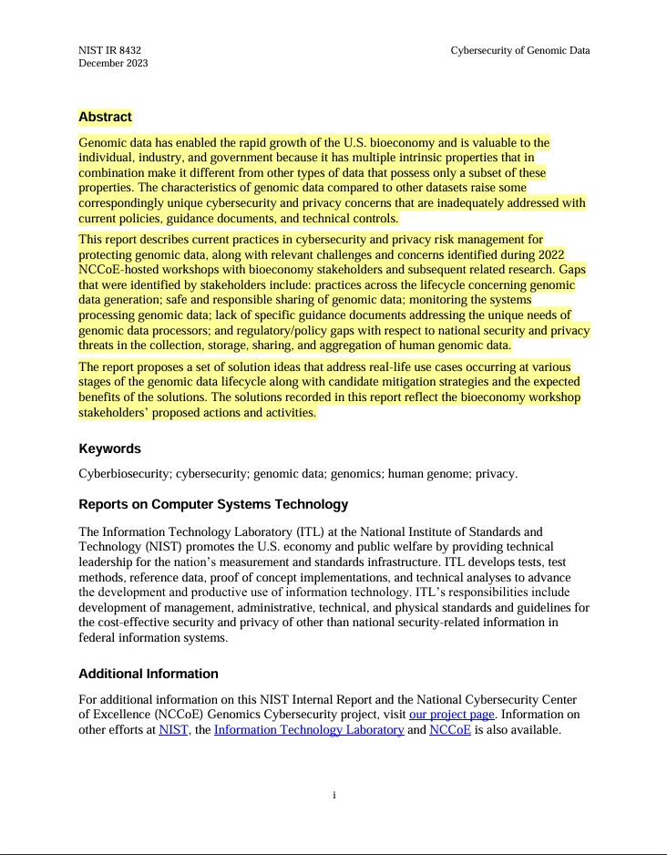
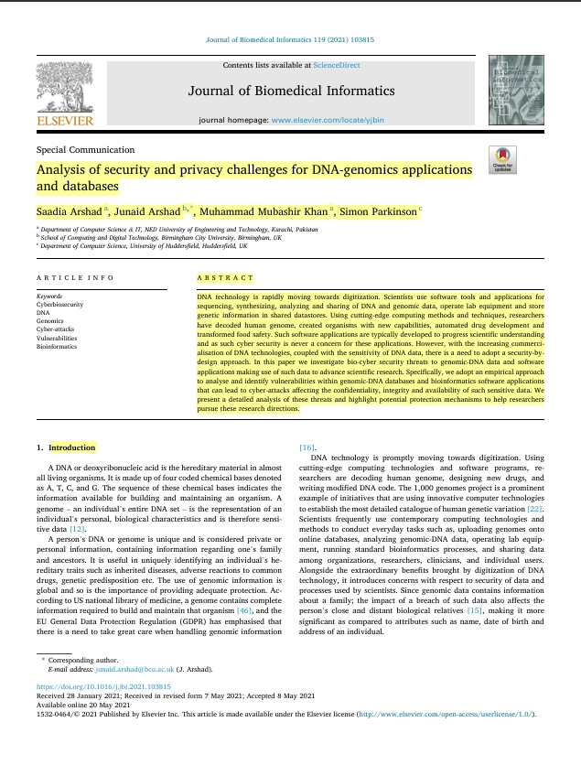
AI Analysis
Quantum Cyber

Slide 3
Defining Genomic Data
A person's complete DNA makeup including genetic sequences, variations, functions, and biological traits
Used for research, medical diagnosises, treatment, and hereditary conditions
Applies computational and statistical techniques to handle about 2 to 40 billion gigabytes of data annually

Slide 4
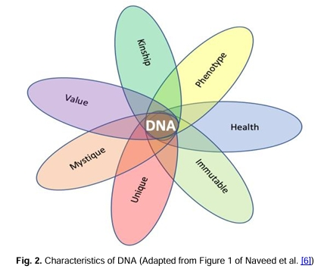
An Overview of Genomic Data
Fig 1. Characteristics of DNA of Naveed et al., (2015) Genomic data is the permanent information contained one’s complete DNA, which attackers can access to re-identify individuals, trace ancestry, or potentially develop bioweapons based on the datasets.

Slide 5
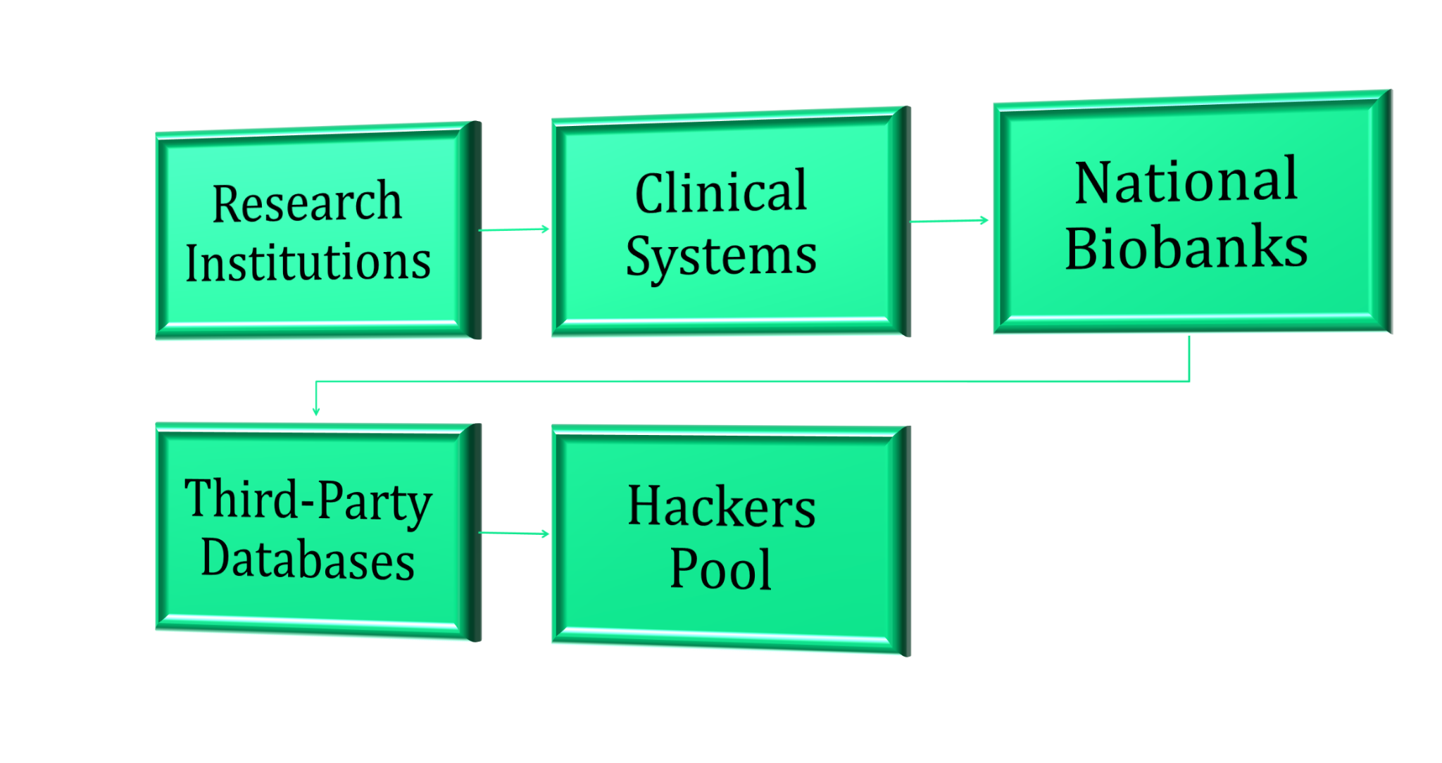
Genomic Data Management
Fig. 2 Genomic Data Management via Allen, L. (2026) By 2025. Over 26 million DNA records existed in 2019 and 1 billion genomes were projected will be sequencedby Arshad et al. (2021). Consists of public genomic databases and cross-shared creating a significant threat pool for hackers.

Slide 6
Analytical Frameworks
A notable gap between genetic data protection and regulations like HIPAA, GINA, and GDPR, which depend on organizational compliance rather than enforced technical standards
A foundational system life cycle built upon vulnerability mapping as a core element
Maps vulnerabilities including collection, sequencing, storage, analysis, and cross-institution sharing and analyze privacy risk during encryption, anonymization, and access control

Slide 7
Analytical Insights
One breach can permanently expose generations of a family through uniquely identifying factors such as biological data and sharing of relatives without consent
A person genome data cannot be changed compare to one’s stolen password or credit card numbers
Bioinformatics software developers prioritize scientific functionality over security, utilizing languages such as C and C++

Slide 8
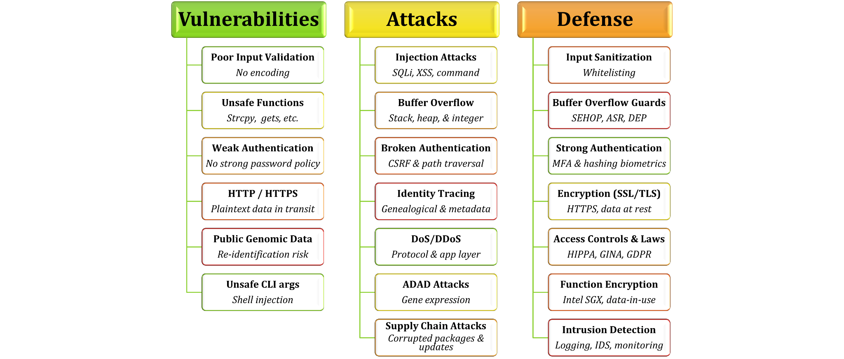
Analysis of Security and Privacy Challenges
Fig 3. Analysis of Security and Privacy Challenges by Allen, L. (2026)
Static analysis of 25 open-source tools developed in C, C++, Java, Python, and PHP found six core vulnerability such as poor input validation, unsafe functions, weak authentication, HTTP/HTTPS, public genomic data, and unsafe command-line arguments.

Slide 9
Potential Threats of AI to Healthcare Systems
Model inversion attacks involve adversaries querying AI diagnostic models to reverse engineer and reconstruct patients’ genetic data
Adversarial ML manipulation involves delicate data that can mislead AI diagnostics risking patient safety and clinical decisions
Membership inference allows AI to identify information about the usage of an individual’s genomic data risking unauthorized disclosure of research patients

Slide 10
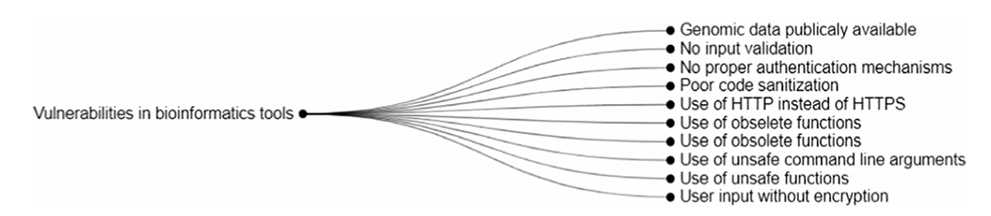
Taxonomies
Fig. 4 Taxonomies Vulnerabilities of Biometric Tools by Arshad et al., (2021) The genomic domain is vulnerable to ADAD (Attribute Disclosure Attacks using DNA), enabling attackers to access gene expression profiles to reconstruct full genomic profiles; obtain metadata like gender, birthdate, zip code, and surnames; and perform injection and buffer overflow attacks via HTTP/HTTPS on biological data.

Slide 11
Limitations of AI Analysis
Perform static analysis not dynamic testing such as runtime testing, penetration testing, and execution of code to validate risks and encryption standards
Projection of impact of vulnerabilities within security architectures in 2021 before the rise of AI and quantum in genomic platforms
Evidence of associated risks and threats remained insufficient and required further investigation which were later investigate in 2025 via Article 2 (Quantum Cyber)

Slide 12
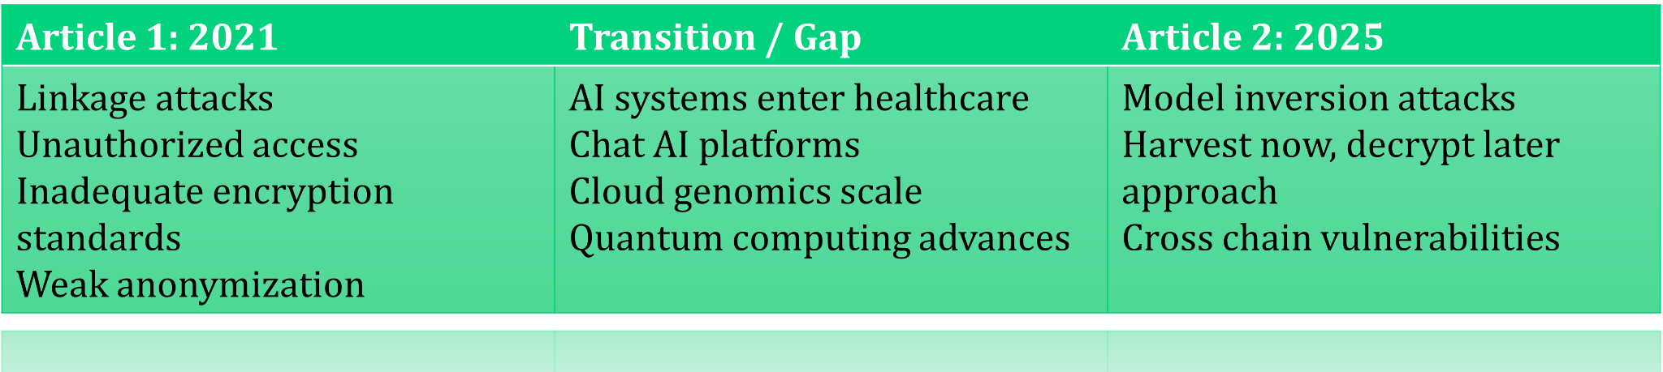
The Evolution of Threats
Fig. 5 Allen, L. Privacy Resilience in Genomic Data (2026) details only 25 open-source tools being used for static analysis which examine the software code without executing bioinformatics software employed in real-world clinical and commercial environment.

Slide 13
Cybersecurity Approaches
Article 2 “Genomic Privacy and Security in the Era of AI and Quantum” shifts from identity-based to authority-based access control limiting credential permissions, in relations to mapping of pre-AI analysis with post-quantum cryptography
Incorporates Zero Trust Architecture (ZTA) mandates ongoing verification of each access request through cryptographic tokens, certificates, and authentication protocols

Slide 14
Security & Ethical Concerns of Quantum
in Healthcare Databases
Atatckers can steal encrypted genomic data via databases today, store them, and decrypt them once quantum computers mature
Shor's algorithm on a quantum computer can break RSA and elliptic curve cryptography used in HTTPS/TLS encryption to decrypt genetic data, targeting biological threats against specific groups (i.e. bioweapon)

Slide 15
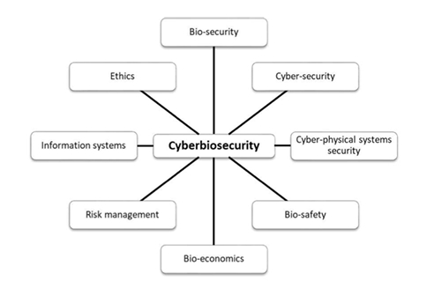
Cyberbiosecurity Measures
Fig. 6 Cyberbiosecurity by Arshad et al. (2021) Both technical fixes and cultural shifts among bioinformatic developers prioritizing security to prevent genomic exploits, improve privacy with cryptography, homomorphic encryption, and parameterized queries to minimize vulnerabilities.

Slide 16
Threat Landscape of Quantum in Healthcare
Genomic data has multiplied and shared across institutions creating interoperability vulnerabilities without a cross-chain governance to limit access control
“Harvest now, decrypt later” tactic store encrypted healthcare data waiting for quantum computing to break current encryption and expose sensitive information

Slide 17
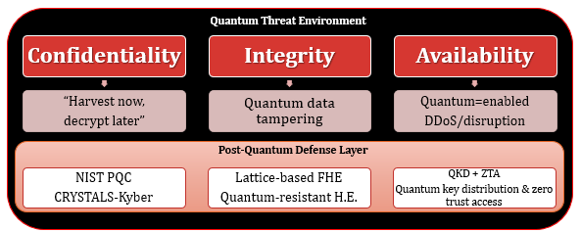
Quantum Environment
Fig. 7 Quantum Treat Environment by Allen, L (2026) Quantum computers can re-identify records by combining genome fragments and AI-based phenotype predictions. Defend with CRYSTALS for key encapsulation and digital signatures along with Fully Homomorphic Encryption (FHE) measures based on lattice problems are more quantum-resistant than RSA encryption.

Slide 18
Cybersecurity Solutions
Sequencer security guidelines mandate no long-term storage of session keys and require the use of post-quantum TLS 1.3, a hybrid key exchange
Post-quantum cryptography standards include CRYSTALS-Kyber for key encapsulation, CRYSTALS-Dilithium for digital signatures, and SPHINCS+ as a hash-based backup
Intrusion detection systems using genomic-specific behavioral baselines amongst all cross-shared institutions

Slide 19
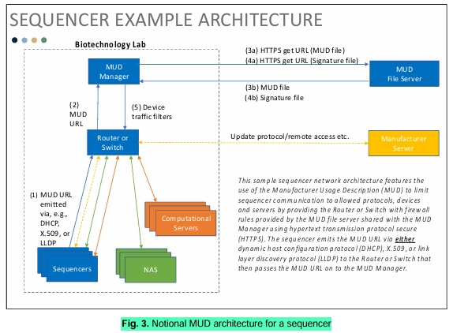
Cybersecurity Architecture
Fig. 8 National MUD Architecture for a Sequencer by Annan et al., (2025) The Manufacturer Usage Description (MUD) secures sequencers like IoT devices by limiting communication, reducing attack surfaces and protecting against data exfiltration and firmware exploits to harvest data for later decryption.

Slide 20
The Relationship Between Analysis
and Cybersecurity Defense
Article 1 established risks and vulnerabilities before AI entered healthcare platforms
Article 2 reflect the impact and mapping of vulnerabilities along with testing incorporating quantum and cryptographic encryption
Both articles demonstrate that genomic data vulnerabilities are real, well-documented, and lack adequate accountability and protection in existing systems

Slide 21
References
Arshad, S., Arshad, J., Khan, M. M., Parkinson, S. "Analysis of Security and Privacy Challenges for DNA-Genomics Applications and Databases." Journal of Biomedical Informatics, vol. 119, 2021, p. 103815. ScienceDirect, doi:10.1016/j.jbi.2021.103815.
Annan, R. K., Noland, J., Perkins, K., Xiaohong, Y., Kaushik, R., Qingge, L. "Genomic Privacy and Security in the Era of Artificial Intelligence and Quantum Computing." Discover Computing, vol. 28, 2025. Springer Nature, doi:10.1007/s10791-025-09627-w.
Naveed M, Ayday E, Clayton EW, Fellay J, Gunter CA, Hubaux JP, Malin BA, Wang X (2015) Privacy in the Genomic Era. ACM Computer Survey 48(1). https://doi.org/10.1145/2767007

